Slide 1
Vocabulary Sheet: Advanced Strings and List
Concatenate | When two or more strings are joined together.
String | A value that is text. This can include numbers but they will be read as text.
String handling | Performing operations on string.
Substring | Part of a string.
Element | A character in a string, or an item in a sequence.
ASCII | Acronym for American Standard Code for Information Interchange. It is used to represent characters with a numerical value.
Third-party libraries | Code that has not been written by the Python developer or the user. They can be imported into your programs to save you from writing them if you don’t have the time or necessary skills.

Slide 2
Vocabulary Sheet: Advanced Strings and List
List | A dynamic data structure that holds items under one name. The items can be of varying data types.
Array | A fixed (static) data structure that holds items of the same data type under one name.
Index | The location of items or elements in a list, array, or string.
Append | Adding to an existing data structure.
Data structure | Used to store data in an organised and accessible way.
Operator | A symbol or function that performs an operation. For example, +.
Traverse | Move through a sequence.
Method | A function that belongs to an object.
Custom built function | A function that you have created yourself and imported into other programs that you have created.
2D array | A static data structure that holds data both horizontally and vertically. The structure is fixed and each element has the same data type.
2D list | A dynamic data structure that holds data both horizontally and vertically. The structure can change during program execution and the data types of the elements can be different.

Slide 3
String handling
You can perform operations with string in a similar way to the operations that you can perform with numbers. A substring is a part of a string.
ASCII is a character set used to represent all of the characters on a standard American or English keyboard.
Each character has a unique code. You can find the codes by looking at an ASCII table.
Performing ASCII conversions in Python
Python has two functions that perform ASCII conversions:
chr(97):This takes an decimal number and returns its character equivalent.
ord("a"):This takes a character and returns its decimal equivalent.

Slide 4
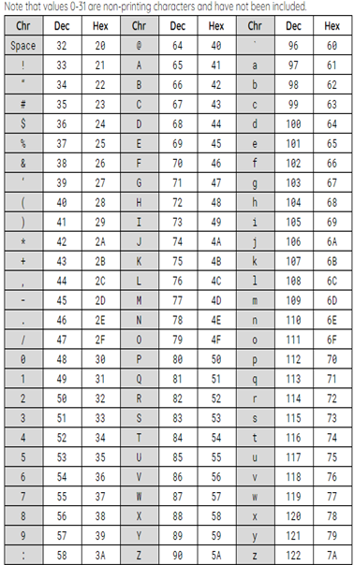
ASCII table.

Slide 5
Array vs List
An array holds multiple items under one name.
An array is a static data structure.
An array is fixed in size and can only contain data of the same type.
The contents can be changed, but items cannot be added or deleted.
The structure must remain
A list is often used as a dynamic data structure.
The size of a list can change. It can also contain data of different types.
This means that you can add and delete items as well as perform other operations on a list that are different to an array.
An array
digits = [0, 1, 2, 3, 4, 5, 6, 7, 8, 9]
A list
player = [“James", “Smith", 22]
Return a list from a function
A function returns a value.
Sometimes you need a function to return more than one value.
A list is a method that you can use to return more than one value from a function.

Slide 6
Two-dimensional list
A list is used to hold multiple elements under one name.
A two-dimensional list allows you to hold a list as one element.
Data in a 2D list can be held in rows and columns.
The same rules apply to 2D arrays and lists as single arrays and lists.
A 2D array must be a predefined fixed size and each item held must be of the same data type.
A 2D list can vary in size throughout program execution and contain multiple data types.

Slide 7
Two-dimensional list
Each column then holds the data for each player.
A 2D list can be used to hold the player names and scores for a game.
Row 0 holds the player names.
 | 0 | 1 | 2
0 | Paul | Anna | Lucy
1 | 4 | 5 | 6
Row 1 holds the player scores.

Slide 8
Index locations
1 2 3 4 | scores = [[“Paul", “Anna", “Lucy"], [4, 5, 6]] print(scores[0][0])
To access a single item in a single list, you need an extra bit of code.
Row
index
Column
index

